Slide 1



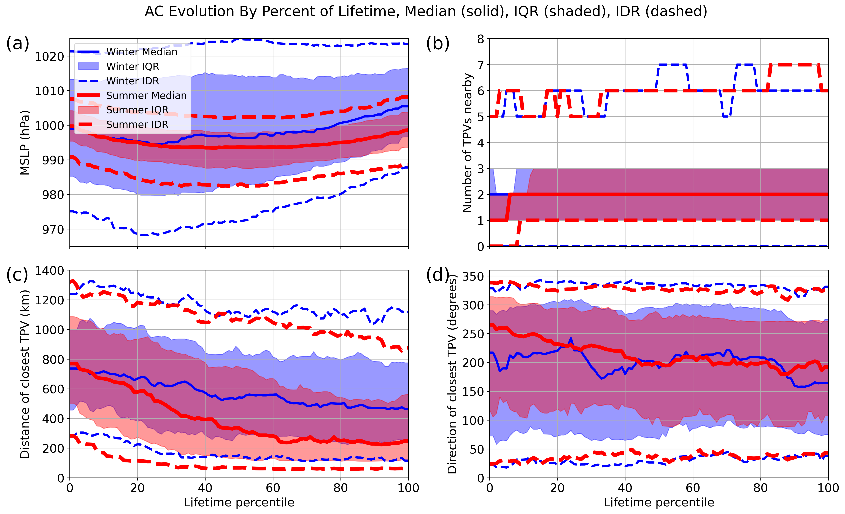
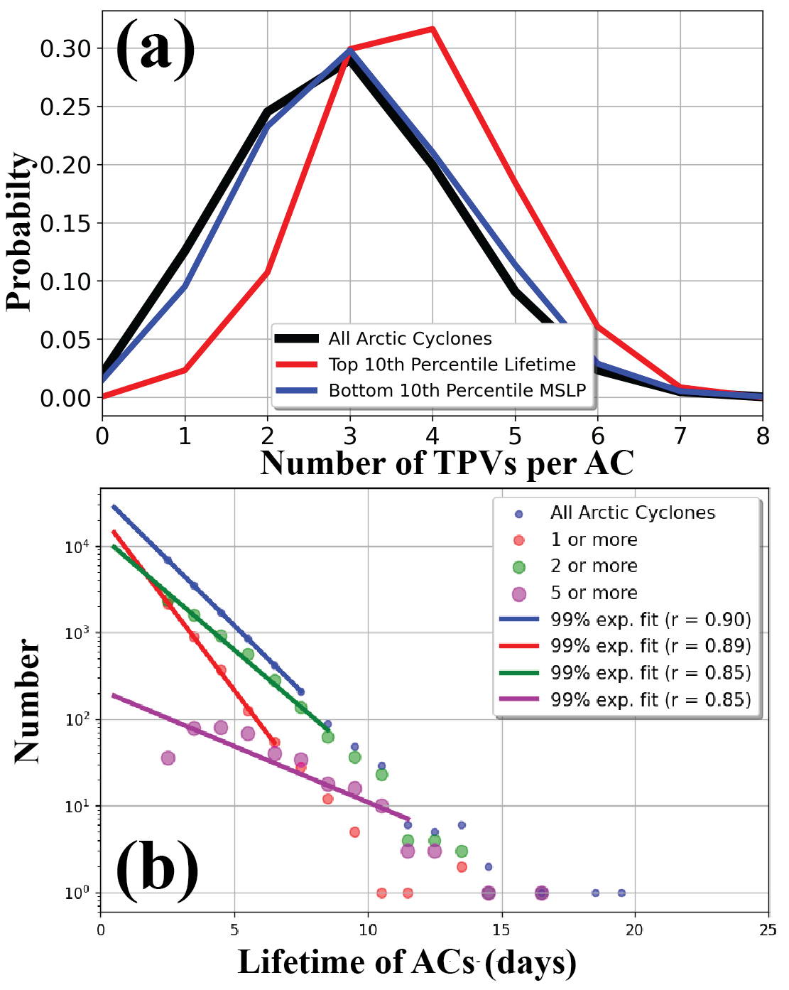
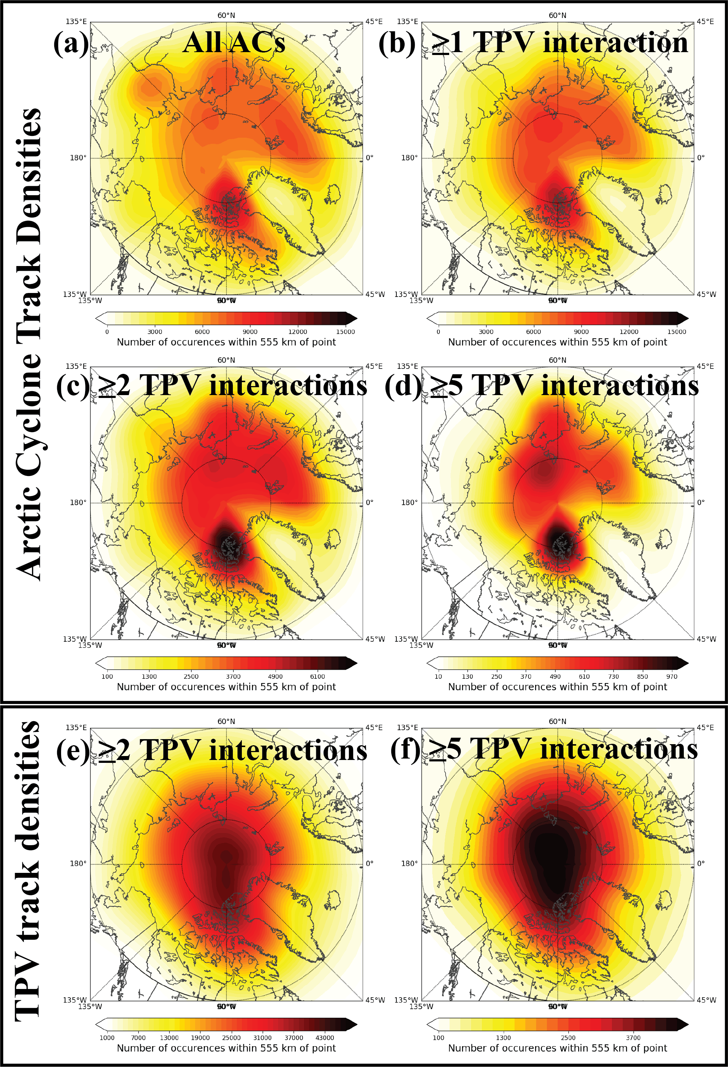
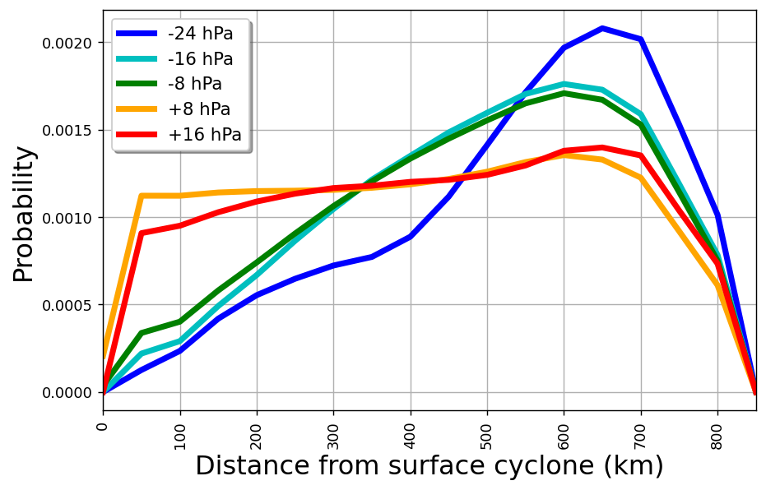
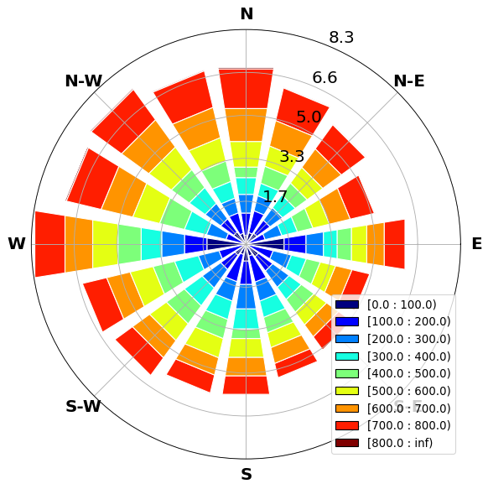
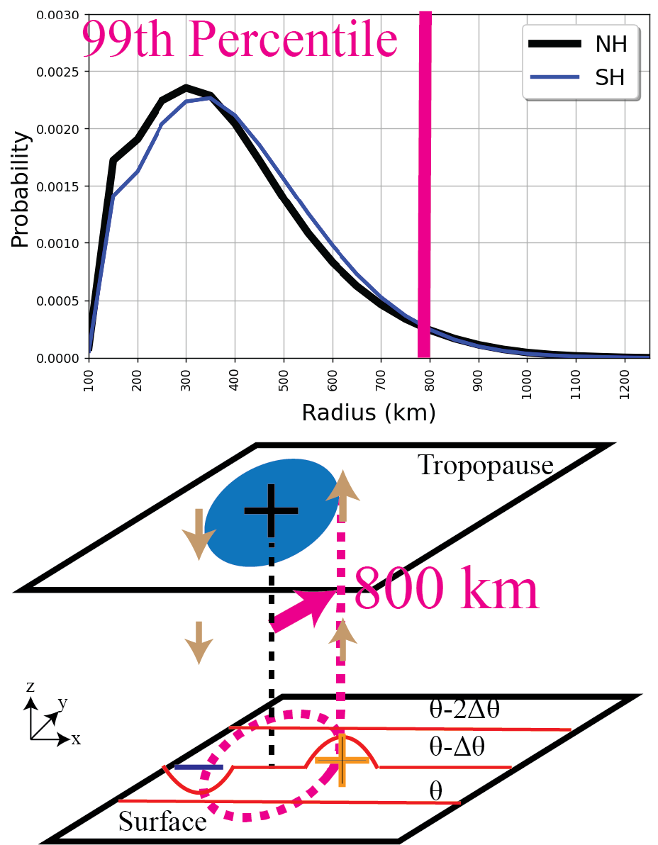
Multiple Vortex Interactions with Tropopause Polar Vortices and Arctic Cyclones
Steven M. Cavallo
School of Meteorology, University of Oklahoma; Norman, OK
Introduction
Rapid sea ice loss events have been observed in the Arctic in conjunction with strong Arctic cyclones^{1,2}. Important precursors to Arctic cyclones are Tropopause Polar Vortices^{3,4}.
Tropopause polar vortices (TPVs) are:
Sub-synoptic vortices characterized by cyclonic tropopause potential vorticity (PV) anomalies and maintained by longwave radiative processes⁵, and
One of the longest-lived features on the planet, with lifetimes of up to 3 months.⁶
Arctic Cyclones (ACs)⁷:
Synoptic-scale surface cyclones located poleward of 60ºN.
The processes that control the large size and longevity remain unclear.
The hypothesis of this study is that AC lifetimes are extended due to multiple TPV interactions with an AC.
Results
Locations and frequencies of Interactions
How often are ACs associated with TPVs?
Conversely, only 8.1% of TPV tracks have a nearby AC.
ACs with multiple TPV interactions occur most frequently in central Arctic and Canadian Archipelago.
II. Statistical Characteristics of Associations
The longest-lived ACs tend to reach their maximum strength early in their lifecycles.
The number of TPVs associated with long-lived ACs typically range from 1-3 but can be as high as 7.
The distance of the closest TPV decreases during the lifecycle of the AC, consistent with a decrease in tilt with height over time as the cyclones weaken¹³.
TPV distance from AC increases as the intensification rate of ACs increase (Statistically significant using two-sided Kolmogorov-Smirnoff test; p-value < 10⁻³)..
III. Longevity vs. Intensity
The longest-lived ACs are associated with more TPVs than the most intense ACs or ACs in general (Stat. significant using two-sided Kolmogorov-Smirnoff test; p-value < 10⁻⁶).
Lifetimes of ACs progressively increase as the number of TPV interactions increase.
These results suggest that “satellite” TPVs may be important in extending the lifetime of ACs. This would allow for the observed equivalent barotropic-like structure of an AC while it is maintained or strengthens^{14,15}.
Category | Percentage (%)
All Tracks | 70.1
Unique ACs | 70.2
2 or more TPVs | 44.0
3 or more TPVs | 20.9
5 or more TPVs | 2.9
What does it mean that ACs are not associated with TPVs 100% of the time?
The 800 km radius is very likely excluding some TPV associations.
Some ACs may be influenced by an Arctic PV anomaly that is advected equatorward and spends less than 60% of its lifetime poleward of 60ºN.
Lee cyclogenesis or Type A cyclogenesis may also be important in some cases.
Figure 3: (a) Evolution of minimum sea level pressure (hPa) of Arctic cyclones by the percentage of the total AC lifetime that has been completed, averaged over all summer (red) and winter (blue) long-lived ACs. Solid lines show the median value, shading represents the interquartile range, and dashed lines indicate the interdecile range. (b) As in (a) but for the number of nearby TPVs within 1500 km of the AC. (c) As in (a), but for distance of the closest TPV to the AC (km). (d) As in (a), but for the direction of the closest TPVs (degrees; North is 0 degrees).
Data and Methods
Data
TPVs: TPVTrack1.0⁸ using ERA-Interim Reanalysis⁹
ACs: Sprenger surface cyclone tracks¹⁰ using ERA5 Reanalysis¹¹
Dates and frequency: 1979-2018, 6 hourly, 2- day minimum lifetime
Methods
Sprenger surface cyclone tracks filtered to include any surface cyclone that exists poleward of 60ºN at any point during lifecycle
Matching a TPV with an AC cyclone:
Figure 6: (a) Probability Density Function of the number of TPVs associated with all ACs (black), the top 10th percentile of AC intensity (blue), and the top 10th percentile of AC lifetimes (red). (b) Annual distributions of AC lifetimes for all ACs (blue), and ACs with 1 (red), 2 (green), and 5 (magenta) or more TPVs associated with the AC. Lines show linear fits to exponential distributions of the top 99th percentile of lifetimes and its correlation (r) to the full data are shown in the legend. All slopes are statistically distinguishable from each other for 95% confidence intervals using the two-sided Student's t-test for the slope of a regression line.
Figure 4: Probability Density Function of the 24-hour intensification rate of AC (hPa) and distance from the nearest TPV (km).
Figure 5: Direction of TPV from AC center. Values of the rings are percentages, and values in the legend are in units of kilometers.
An “Association” or “Interaction” between a TPV and surface cyclone (AC) is considered if an AC lies within 800 km of the center of a TPV.
Figure 1: (Top) Probability density function of maximum TPV radius for the Northern Hemisphere (NH; Black) and Southern Hemisphere (SH; Blue). (Bottom) Schematic illustrating the remote effect from a cyclonic tropopause PV anomaly on the surface. Light brown arrows represent the horizontal wind speed and direction. The vertical black (magenta) dashed line denotes the center location (location of maximum wind speed) of the TPV. The solid red lines on the surface panel represent isentropes. Plus (negative) signs indicate cyclonic (anticyclonic) PV anomalies. Based on Figure 1 of Hoskins et al. (1985)¹².
Figure 2: Track densites of (a)-(d) ACs and (e)-(f) TPVs for (a) all ACs and when there is at least (b) one TPV, (c) two TPV, and (d) 5 TPV interactions. (e)-(f) Same as (c)-(d), except for the corresponding TPV track densities.
Conclusions and Future Work
Lifetimes of Arctic Cyclones are longer when there are one or more TPV interactions with the Arctic Cyclone. There is no clear preferential direction for where a TPV may lie with respect to Arctic Cyclone.
As the number of TPV interactions with the Arctic Cyclone increase, the lifetimes of ACs tend to increase.
Most Arctic Cyclones interact with at least one TPV (70.1% of the time), while conversely, TPVs are not commonly associated with an Arctic Cyclone (8.1% of the time). This confirms the precursor role that TPVs have on ACs.
The distance of the closest TPV to an Arctic Cyclone decreases during the lifetime of an Arctic Cyclone, and the total number of associated TPVs is greater for the longest-lived Arctic Cyclones. This suggests that satellite TPV and TPV mergers may be an important component of Arctic Cyclone longevity.
Future work is needed to investigate the detailed nature and fundamental processes of the vortex interactions.
References and Acknowledgements
¹ Simmonds and Rudeva, 2012. Geophysical Research Letters, 39 (23).
² Yamazaki et al., 2015. Journal of Geophysical Research-Atmospheres, 120 (8).
³ Johnson and Wang, 2021. Monthly Weather Review, 149 (5).
⁴ Wang et al., 2020. Journal of Climate, 33 (5).
⁵ Cavallo and Hakim, 2013. Journal of Atmospheric Science, 70 (11).
⁶ Bray and Cavallo, 2022. Weather and Climate Dynamics, 3 (1).
⁷ Screen et al., 2018. Current Climate Change Reports, 4 (4).
⁸ Szapiro and Cavallo, 2018. Geoscientific Model Development, 11 (12).
⁹ Dee et al., 2011. Quarterly Journal of the Royal Meteorological Society, 137 (656).
¹⁰ Sprenger et al., 2017. Bull. Amer. Met. Soc., 98 (8).
¹¹ Hersbach et al., 2020. Quarterly Journal of the Royal Meteorological Society, 146 (730).
¹² Hoskins et al., 1985. Quarterly Journal of the Royal Meteorological Society, 111 (470).
¹³ Tao et al., 2017. Geophysical Research Letters, 44 (19).
¹⁴ Aizawa and Tanaka, 2016. Polar Science, 10 (3).
¹⁵ Yamagami et al., 2017. Atmospheric Science Letters, 18 (7).
Support for this project is greatly appreciated from ONR N00014-18-1-2223
and from NSF-OPP 191-8557. Thank you to the Arctic And Antarctic Research Group (AAARG) for the many helpful and enlightening discussions.

